Slide 1
FIGURE IT OUT!!!
Under guidance of
Mr. B. GOPALAKRISHNAN,
Associate Professor,
Department of Information Technology,
BIT,
Sathy.
GOUTHAM S
JANAGAN R
BALAJI VISWANATH M

Slide 2
Abstract
Building an app that will allow a student to post about a project where a wide community can offer a huge amount of support to that student, will accelerate the pace of the project's progress. This app creates a network of like-minded people based on their technological interests. Using it, anyone can post a query and get help from people with prior experience.

Slide 3
Problem Statement Addressed
There are various possibilities for sharing information about their personal lives on social media sites like Instagram, while others like LinkedIn assist with sharing about their professional lives. However, there is no media platform for students, especially those in schools and colleges, to showcases their side hustles, inventions, innovations, projects, journals, and so forth.

Slide 4
Existing Solution to the Problem Addressed
There are some online platforms such as Github, kaggle, Stack overflow which helps to rectify and solve the errors in projects. There are some applications such as instagram, Linkedin, etc where as instagram is an online platform where people share about their personal lives, photos, videos, etc.. Linkedin is an employment oriented online service platform where professionals share about their career progressions.

Slide 5
Proposed Solution to the Problem Addressed
We are proposing to develop a student-focused application. This will help them to share stuff about their projects and ideas, seek guidance from experts, get ideas, give ideas, create a portfolio.
Posting an interesting idea on this platform can attract potential sponsors willing to invest in that idea. That allows students who have lack of resources to pursue their idea.

Slide 6
Project Work Plan
We are going to use a software called Flutter which is a google portable UI toolkit used for creating a compiled applications for mobile, web and desktop form a single codebase. Flutter uses Dart programming language which has same features like Kotlin and Swift for creating an app and creating API to interface frontend and backend.

Slide 7
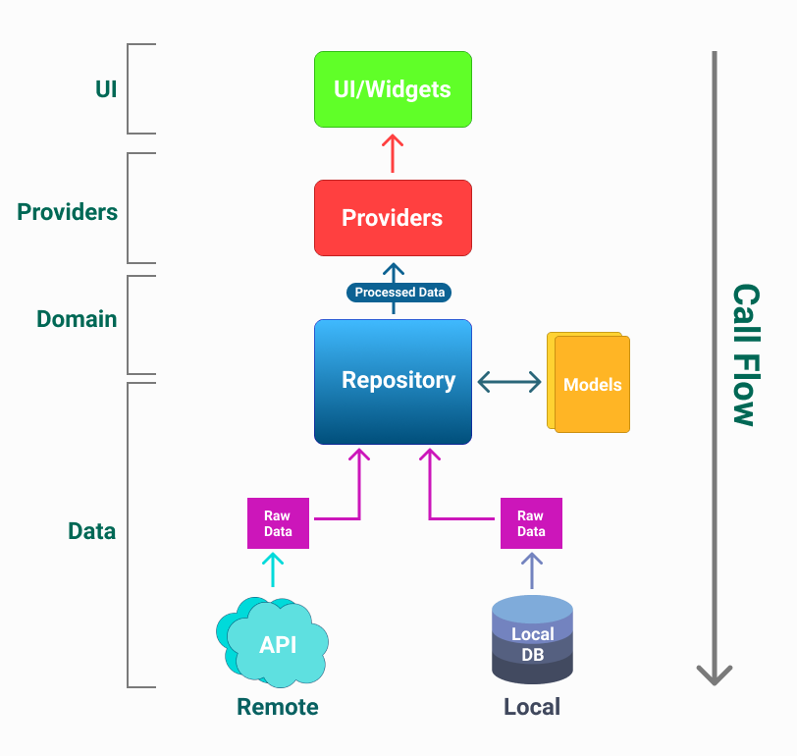
Block Diagram:

Slide 8
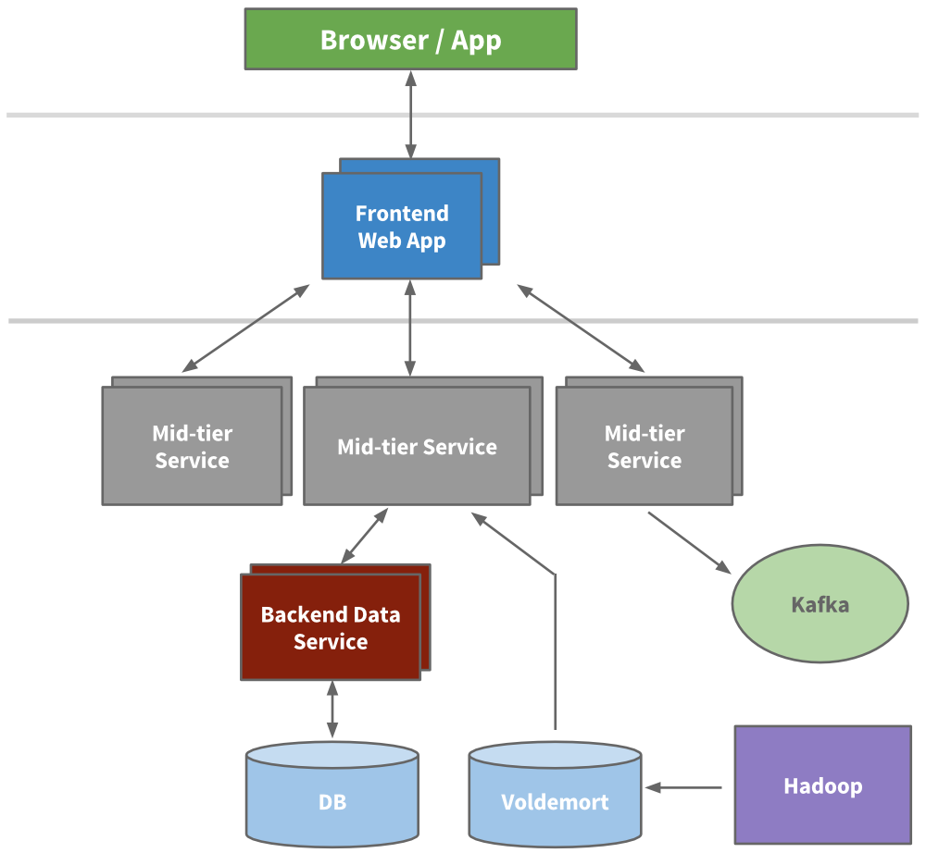
Flow Chart

Slide 9
Effective utilization of the Modern Tool & Cloud
We are using Flutter, an app development framework developed by Google, for creating a student –focused social media app.
It is used to develop cross platform applications for Android, iOS, Linux, macOS, Windows from a single codebase.
Google Firebase is a Google-backed application development software that enables developers to develop iOS, Android and Web apps.
Firebase provides tools for tracking analytics, reporting and fixing app crashes, creating marketing and product experiment.

Slide 10
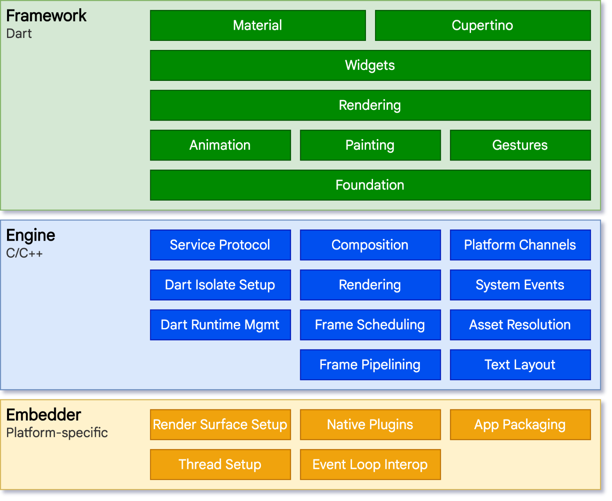
Technology stack & use case

Slide 11
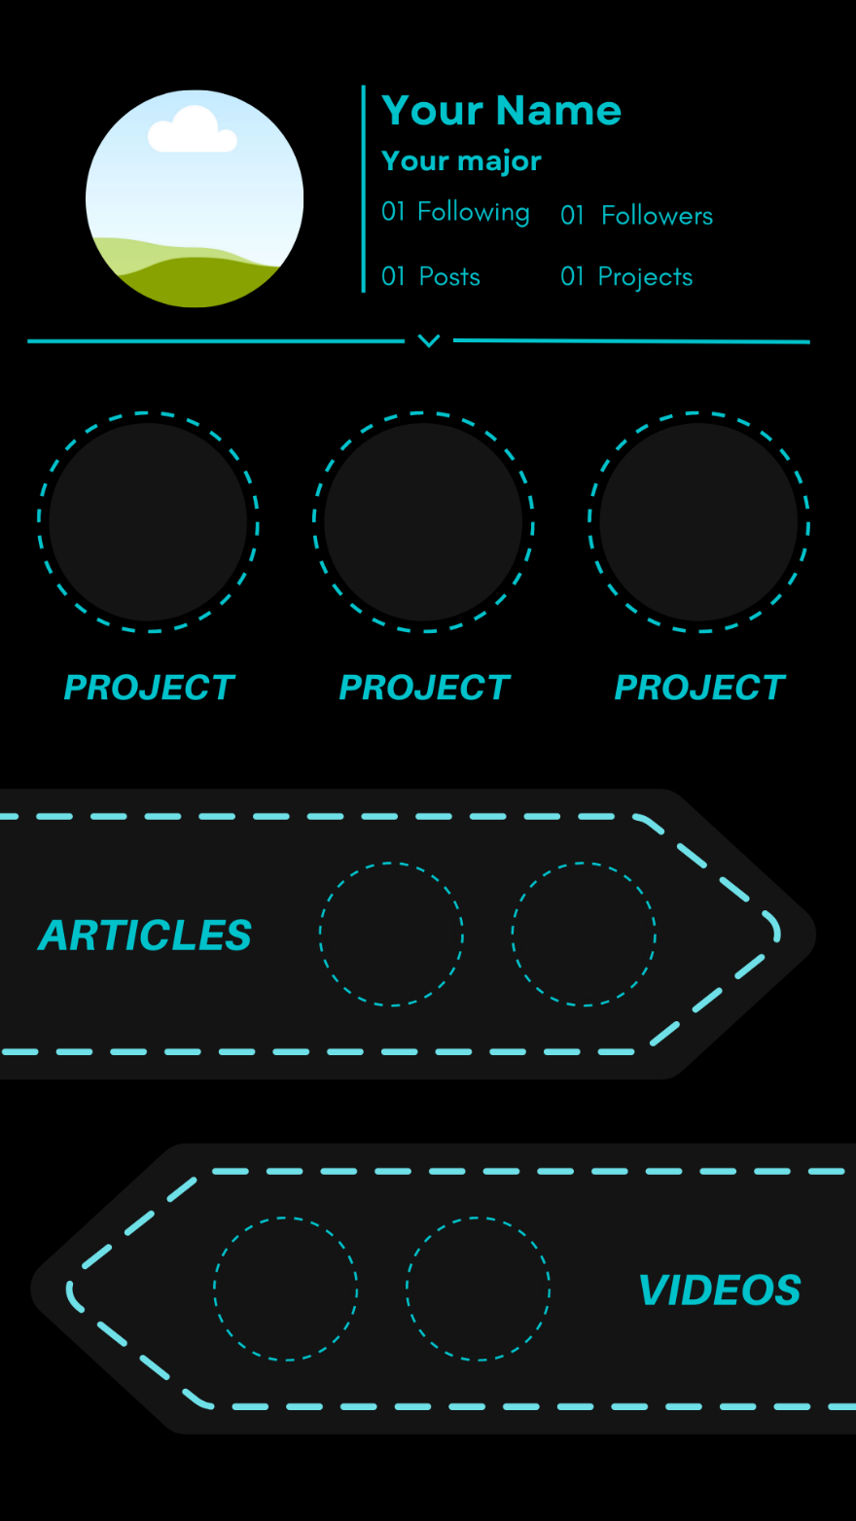
Prototype & Sample Output
This picture portrays the profile page of the app before uploading any documents

Slide 12
Analysis of Results & Discussions
It will create a great impact on students community and it will be helpful for students those who are actively engaging in project works.
We can generate data about emerging technologies based on the posts of students and using this data we can predict a technology's development.
Through the app, students can post brief descriptions of their projects and those posts can be used to create a portfolio that can serve as a collection of proof of their work.

Slide 13
Cost Benefit Analysis (List of Components / Service Used)
S.No | Component Name | Specification (IC number or Range or Value) | Unit Cost | Total Cost
1. | Flutter | Flutter 2.5 | 0 | 0
2. | Canva | Canva version 3.0 | 0 | 0
3. | Android Studio | Android Studio 2021.1.1 (Bumblebee) | 0 | 0
4. | Firebase | Firebase CLI v9.12.1. | 0 | 0
5. | Heroku | Heroku-20 | 0 | 0

Slide 14
Working video Link (If available)
(demo working Video shall be inserted)

Slide 15
References
https://www.appventurez.com/process/development-methodology
Bill Philips, Chris Stewart (2019) , “Android Programming: The Big Nerd Ranch Guide”
https://www.youtube.com/watch?v=rZLR5olMR64
https://www.geeksforgeeks.org/flutter-tutorial/

